Slide 1
MDST Earthquake Group 5
Oliver Gao, Alex Hu, Filip Saulean, Tiffany Tan

Slide 2
One-Hot Encoding
Because several categories of our data, such as “foundation_type” or “roof_type”, are categorical, we need to encode these so that we are able to plug them into our model in the future
To encode our categorical data, we could do integer encoding, or one-hot encoding
We wanted to use one-hot encoding since our data is randomly assigned variables, so label encoding might cause the incorrect assumption that there is some sort of “hierarchy” between the variables
Notes:
Link to Google colab: https://colab.research.google.com/drive/15LDVAwsIQ9y76lDEoIwTJHoRiEqrciLY?usp=sharing

Slide 3
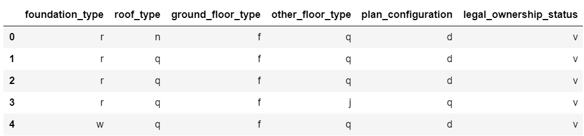
Encoding (cont’d)
This is how our original data looked like:

Slide 4
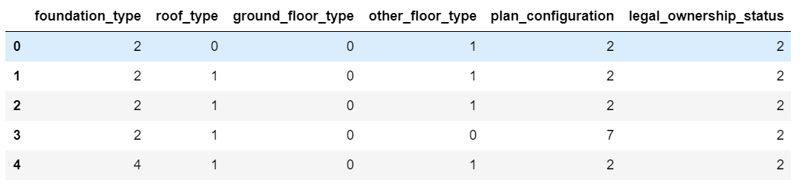
Encoding (cont’d)
With integer encoding, the numbers don’t really make much sense:

Slide 5
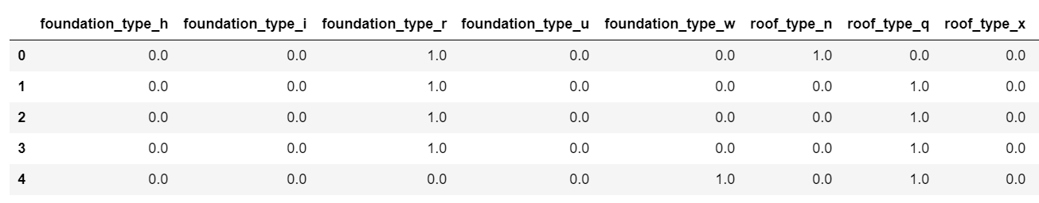
Encoding (cont’d)
And our final result through one-hot encoding:

Slide 6
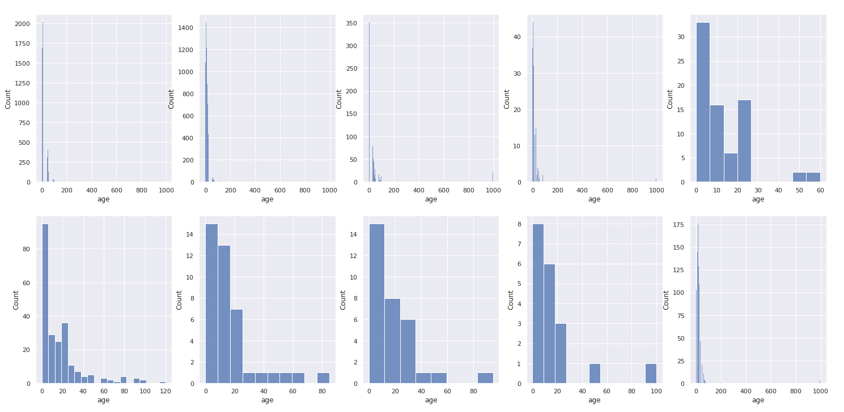
Removing Outliers
In the age data values there were 1107 outliers which were all 995. This is out of a total of 208481 data values for age. We removed approximately half a percent. Age values jumped from 200 to 995 with nothing in between.

Slide 7
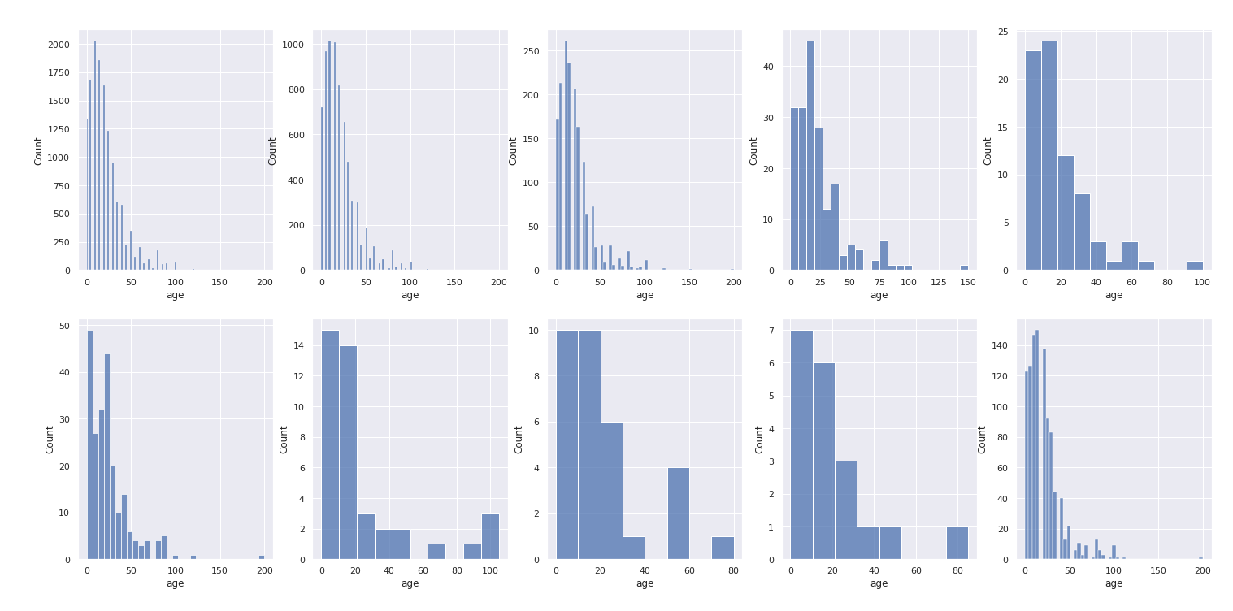
Removing Outliers

Slide 8
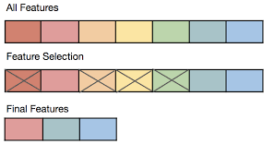
Feature Selection
What is it?
selecting a subset of relevant features to build a model with
removing irrelevant and redundant features from the data
Why we are going to do it
create an accurate predictive model that requires less data
fewer attributes = simpler model = easier to understand and explain
Methods to do this
Filter (consider features independently)
correlation coefficients, chi-square test
Wrapper (a search problem)
different combinations of features are compared
to other combinations and model accuracy
is compared

Slide 9
Features to Remove
In our preliminary feature selection process, we have decided to remove these features:
height_percentage or count_floors
land_surface_condition
position
geo_level_id_1
geo_level_id_2

Slide 10
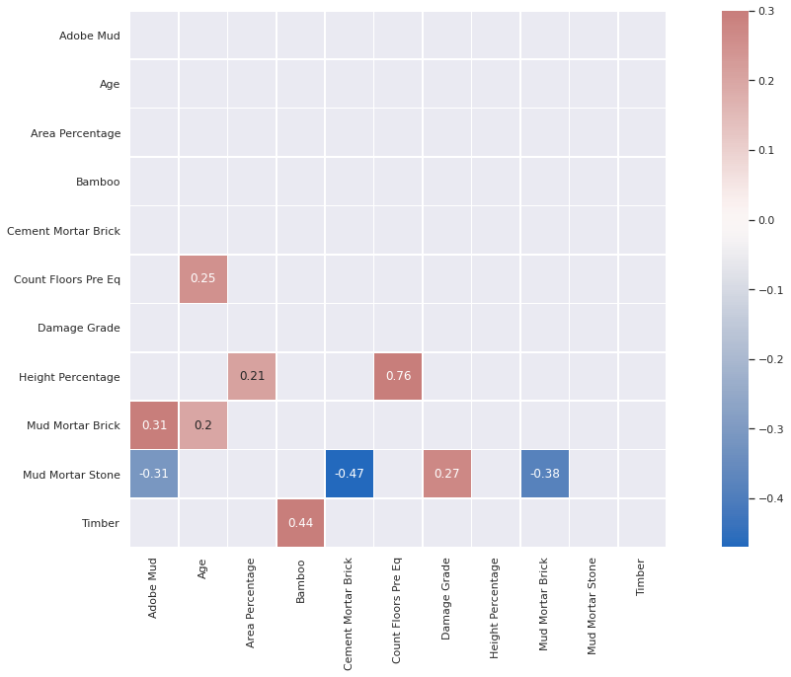
Height and Count Floors
An example of using a filter method: correlation
coefficient matrix
Conclusion: height_percentage and count_floors
are redundant features
correlation coefficient = 0.76

Slide 11
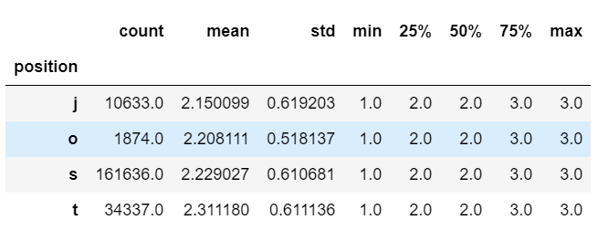
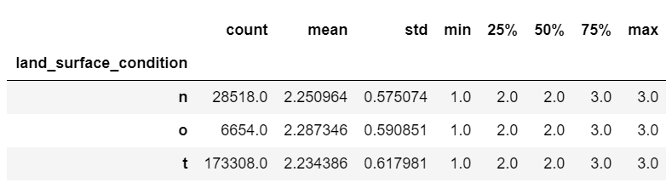
Land Surface Condition and Position
We chose to disregard these two categories because there doesn’t seem to be much variance between damage for each category
For example, here is a quick breakdown of the damage grade for both these categories, and as you can tell, there is little variance between their means

Slide 12
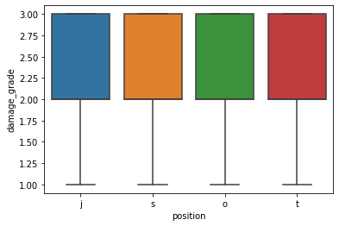
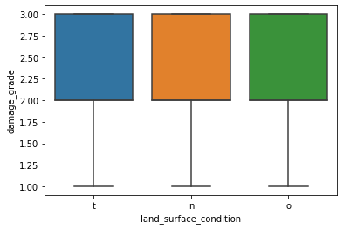
Condition and Position (cont’d)
And for a visualization of how the data is distributed:
So since these two categories are (on average) quite similar for all different categories, we chose to remove these features from our data set.

Slide 13
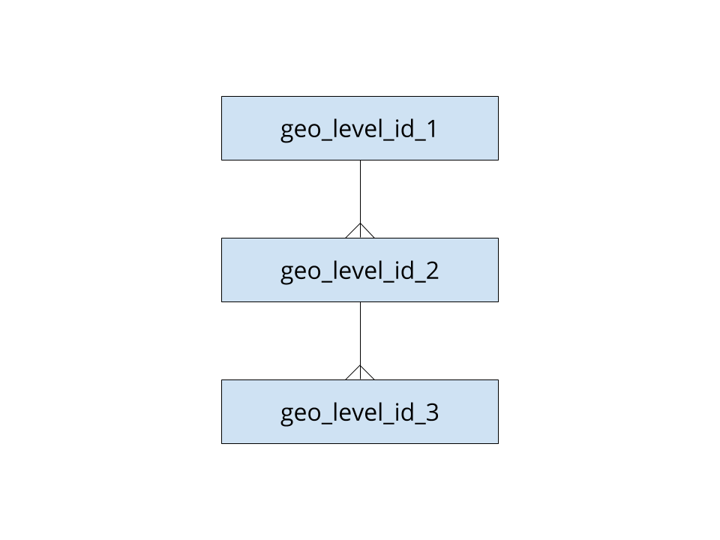
geo_level_id_1 geo_level_id_2

Slide 14
Performance Metric

Slide 15
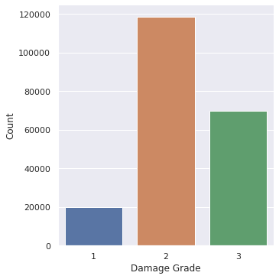
f1-score
micro-average

Slide 16
Selecting Best Model Architecture

Slide 17
Regression or Classifier?
Is damage_grade categorical or interval data?

Slide 18
Classifiers
What We Have
208480 data points
39 initial features
Multiclass labels
Potential Models
Linear Model optimized by Stochastic Gradient Descent + Kernel Approximation
Random Forest Classifier

Slide 19
Fin

